Slide 1
Mental Health Waiver Provider Meeting
October 29, 2024

Slide 2
Agenda
Waiver Update
Average Enrolled by Month
Staffing Updates
RA Training Process
RA Post-Education Trainings
Use of secure email
Gainwell Re-credentialing
Monthly notes
Monthly RA note quality
Authorizations
EVV Compliance rates
MHW Advisory Council

Slide 3
Waiver Update (as of 10/28/2024)
Active participants on the waiver: 524
Actively planning for admission to waiver (MHW & MFP): 38
Referrals pending disposition (MHW & MFP): 68
Waitlisted referrals for MHW community: 0
Community Census for Waiver Year 15: 615
Additional Slots for MFP participants Waiver Year 15: 45
If you are making a referral to the MHW please remember to send in any psychosocial and functional assessments to assist with eligibility determination.

Slide 5
Staffing Updates
Nicole Kavalan resigned from her position effective September 5th. The position has been filled by Shay Finnucan who starts November 4th.
Amanda Clavette has resigned from her position and her last day is November 1st. Amanda Smith has resigned from her position and her last day will be December 20th.
We are currently looking to fill CSC positions in both the New Haven and Danbury areas.
Please reach out to Joann Rotar or Ann Marie Luongo with any questions about case coverage.

Slide 6
RA Training process
The On Demand RA training is now live ☺
New RA staff can now access the training at their own convenience and either complete at one time or over multiple sessions.
Agencies simply need to provide ABH with the name and email address of prospective MHW RA staff.
This training is for potential MHW RA staff only. Please do not access or request access for staff working on other waivers/programs.

Slide 7
RA Post Education Trainings
Please remember that RA staff should be receiving some type of boundaries training within 6 months of employment. RAs are still required to have 6 hours of additional training per year. We will continue to send out information regarding trainings available through ABH, DMHAS and the community.
The following trainings are on the ABH website for staff to review (under the CSP section):
Fall Prevention Training
Diabetes 101 Training
Medicaid Requirements for MHW application and renewals

Slide 8
Use of secure email
Please remind staff that if personal client information is needed to be included in an email, that the email should be sent securely.
Personal information includes: name, date of birth, social security number, Medicaid number.
Remember to check the subject line-no PHI should appear there.
WOS ID numbers are not identifiable and can be used safely in email communication if needed.

Slide 9
Gainwell Re-credentialing
MHW Provider agencies must re-credential with Gainwell every 2 years. This is separate from the ABH re-credentialing process
If you credentialing with Gainwell lapses, your agency will not be able to receive new authorizations or bill until you are re-credentialed with Gainwell.
Gainwell will require you submit a letter from ABH confirming that you are currently credentialed with ABH. Please reach out to Thelma Boisseau or Ann Marie Luongo to obtain this letter.

Slide 10
Monthly Progress Notes
Please remember that your agency will be required to submit a note for any authorization that is active for at least one day during the month. Please check to make sure that clinicians close out interventions when you stop providing service. If you are not getting a timely response, please reach out to Ann Marie Luongo or Jenny DeMars at ABH.
Reminder the only note now due for CSP is the Monthly Summary.
Failure to complete timely notes may lead to agency being placed on hold for new referrals.

Slide 11
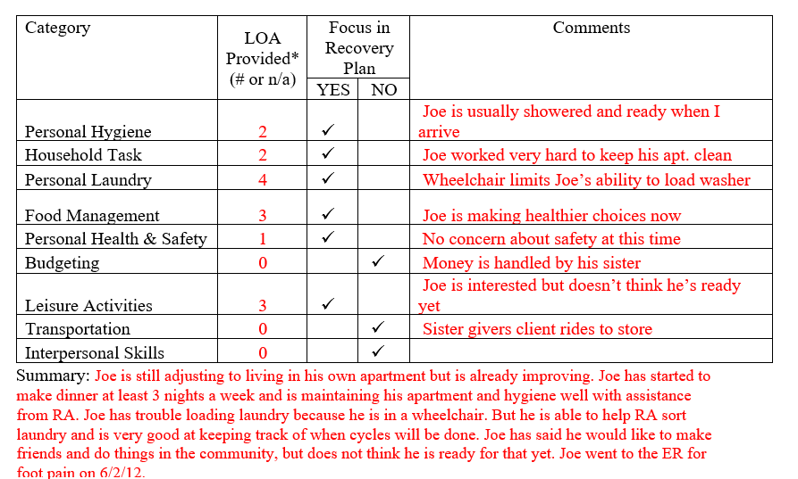
Monthly RA note quality
Please remember to provide as much information as possible to the RA monthly note. Paper RA encounter notes were discontinued with the understanding that monthly notes would sufficiently replace them.

Slide 12
Authorizations/Billing Issues
If an authorization is missing in either the ABH portal or Gainwell system, please reach out to ABH for assistance.
Emilie LeBlanc: eleblanc@abhct.com 860-704-6123
Jenny DeMars: jdemars@abhct.com 860-704-6254
If an authorization is missing in Sandata, please contact Sandata and Gainwell for assistance. (Reminder that auths can take 24-48 hours to reach Sandata)
Sandata: ctcustomercare@sandata.com 855-399-8050
Gainwell: ctevv@gainwelltechnologies.com
If you do not see a new authorization in any of the systems within 3 days of expiration, please reach out to the appropriate contact.

Slide 13
EVV Compliance Rates
Direct Care staff should be signing in and out either on a mobile app or the client’s home phone. If any client has an issue with the use of their phone, please contact their clinician immediately.
EVV Compliance rate requirement: 75%
ABH will run reports on EVV compliance rates and include them on Quarterly Report Cards. Agencies who do not continue to meet compliance rates will be placed on hold from receiving new referrals.

Slide 14
MHW Advisory Council
Meets twice a year in April and October
Open to any MHW provider to send a representative
Meetings will now be held both in person and virtual. If you are interested in attending virtually, please contact Katie Daly for the link. (Katie.daly@ct.gov)
We encourage staff to identify MHW participants who might be interested in participating. Staff can bill for time spent with participant at meeting.

Slide 15
ABH Contact Information
Ann Marie Luongo, Program Manager (general waiver info, clinician info/issues, adding staff to ABH portal)
(860) 704-6211 aluongo@abhct.com
Jenny DeMars, Quality Assurance Supervisor (client eligibility, report cards, audits, notes)
(860) 704-6254 jdemars@abhct.com
Thelma Boisseau, Program Specialist (credentialing questions, RA trainings)
(860) 638-5341 tboisseau@abht.com
Emilie LeBlanc, Claims Coordinator (authorization and claims issues, report cards, client eligibility)
860-704-6123 eleblanc@abhct.com
Laura Biggs, Utilization Review Support (critical incident reports, client surveys, provider surveys, report cards)
(860) 704-6182 lbiggs@abhct.com
FAX NUMBER 860-920-4456

